Slide 1
Software methodology
Module V

Slide 2
4. Concept of Applications
What constitutes an application?
Design process
Example
Application Models in Android
Summary

Slide 3
So What Is an Application?
In an abstract sense:
A piece of software that something specific and useful?
Set of programs?
Something that gives device more capabilities?
Runs on top of underlying specific hardware and infrastructure software?

Slide 4
Design process

Slide 5
Workflow
Scoping
Performance management
UI design
Memory layout and data structures
Communication and I/O

Slide 6
Scoping
Fundamental purpose of the application
What it does
What it does not
For a mobile version of a workstation application, a subset of features to be selected
Relative priority to be given to features; the priority will then guide the development iteratively
Priority should therefore be based on the importance of the feature to the user
Easiness of activities performed seldom can be compromized
Scoping can be helped with paper protos, mock-ups, or running prototypes

Slide 7
Importance of Performance
General responsiveness metrics needed (how fast an application starts, shuts down, opens file, etc)
Forces to consider sequences of events that occur when the user performs an action
Test all assumptions with a real device; do not trust the emulator
Start with key features, then advance to less critical ones
Assume that more will be expected in the future
Use e.g. an old hardware platform for less capable executions
Focus on real bottlenecks, not on the ones that one can most easily find or fix
It is the overall performance that counts
Rule of thumb: Start with data structures, their layout in memory, algorithms, UI design

Slide 8
User Interface Design
The device keeps the user informed and does not halt at random times
Problems
Tendency to repeat actions if seemingly nothing happens
Device specific design of UI
Small screen, clumsy keyboard
”One size fits all” vs. application-specific features and devices

Slide 9
Data Model and Memory Concerns
Data representation bears great significance to memory consumption
Disk or memory?
Static vs. dynamic?
Stack vs. heap?

Slide 10
Communication and I/O
Local (e.g. files) and remote resources (e.g. services offered by a server in a network) to be considered
Local access is usually relatively fast
Remote access commonly introduces a longish round-trip time
Level of abstraction in communication significant
binary streams -> text streams -> XML forward only readers and writers -> XML document object model
Also affects development time
Costs of a connection
Download a lot of data when WLAN is available, use local proxy when only GPRS can be used

Slide 11
Workflow
Scoping
Performance management
UI design
Memory layout and data structures
Communication and I/O

Slide 12
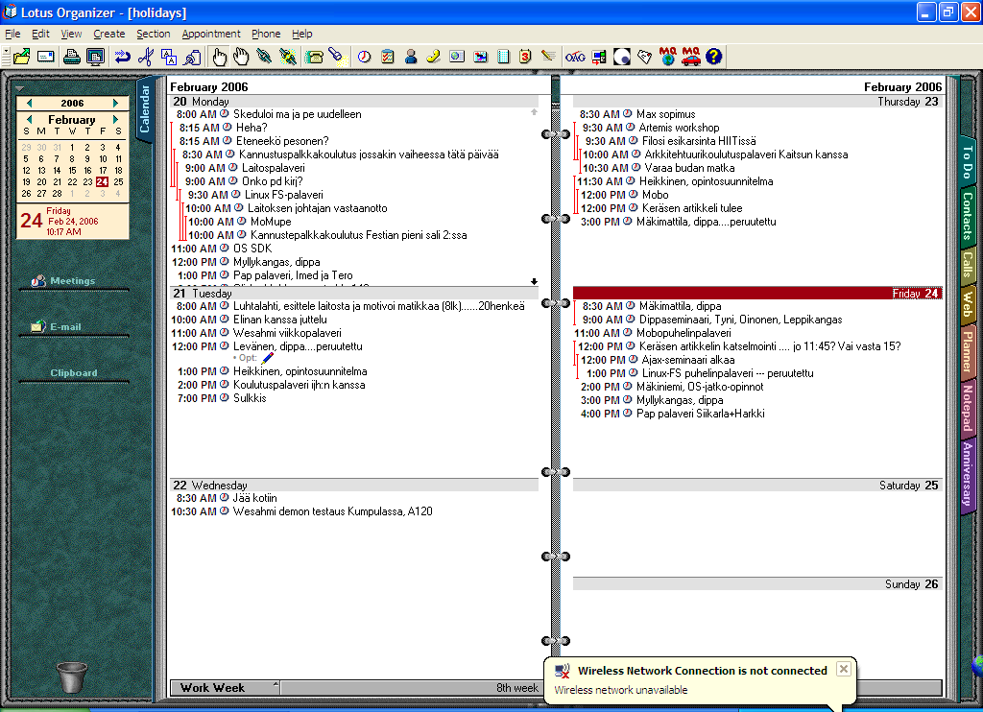
Scoping

Slide 13
Scoping .... Cont’d
Calendar entries
Reminders
Contacts
Day-week-month view
Import/export (synchronization)
Lunar phase
Connectivity/group features
Time zones
Repeated events
Overlapping treatment
Public holidays
Automatic meeting coordination
”Date” operations

Slide 14
Performance
Implementation of a mock-up
First build for a real device
Also tested with the device

Slide 15
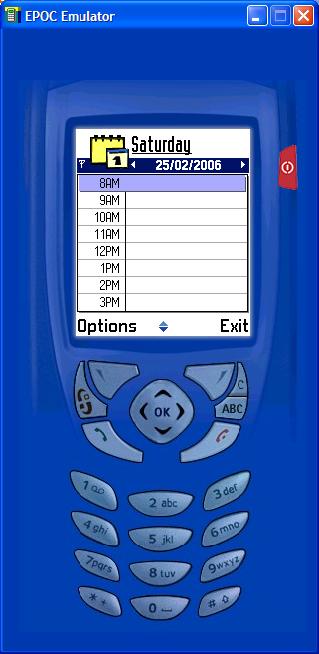
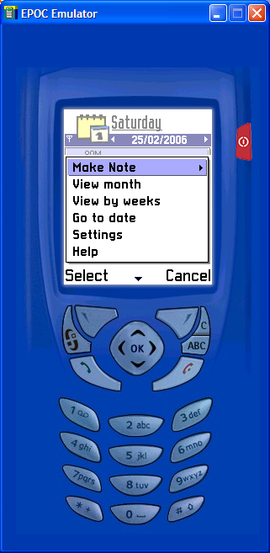
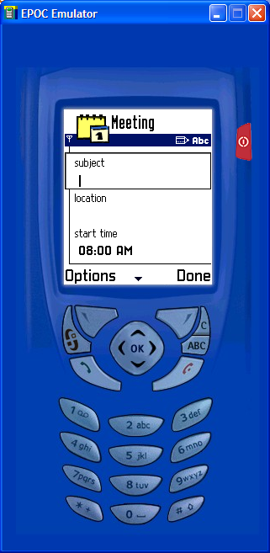
UI Design

Slide 16
Data Structure?

Slide 17
I/O and Communication
Server Synchronization?
On the fly update with e.g. SMS? Or only pull when the user has suitable connectivity access?

Slide 18
Introduction to Iphone Apps
it is about creating mobile web apps for the iPhone and beyond.
Because when we are talking about iPhone web apps, we are actually talking about WebKit, the mobile web browser behind the iPhone and iPod touch, and also the device browser in some of the best-selling smartphone platforms, like the Nokia Series60 (or S60), Android, Palm’s webOS, and more.
In a short period, WebKit went from being just the core technology for Apple’s web browser Safari to one of the top, most proven mobile browsers in the world.

Slide 19
What is WebKit
Webkit is an open source web browser engine that was originated by Apple Inc. and currently powers browsers such as Google Chrome, Apple Safari, the default iOS browser, and the default Android browser
Every browser is backed by a rendering engine to draw the HTML/CSS web page.
IE → Trident
Firefox/Seamonkey → Gecko
Opera → Presto
Safari/Chrome → WebKit.

Slide 20
What Makes it a Mobile Web App?
Technically, any content viewed in a web browser can be considered a website, but we are certainly seeing a subset of experiences that are defined in the mobile context as web applications, or web apps
The popularity of mobile web apps for the iPhone and iPod touch has caused many other mobile browser makers to emulate Apple’s techniques, but some are introducing their own proprietary methods

Slide 21
Characteristics of a Mobile Web App
Is an application-like experience that alters existing views, in place, instead of loading new pages like a traditional website
Uses client-side (or offline) storage for local data
Heavily uses DHTML or Ajax to create the user experience
Has a defined viewport for the mobile context
Can run in full-screen mode

Slide 22
Creating a Mobile Web App
Prior to the iPhone, if a site was built for mobile browsers, it was simply referred to as a mobile website, or as web content designed to be viewed within a web browser.
But the reality is that creating a mobile web app isn’t really that much different than creating a normal mobile website.

Slide 23
Defining the Viewport
The viewport is the area within a browser where content can be seen by the user.
On the desktop, the user can resize the browser window and therefore the viewport.
In mobile devices, the browser area cannot be resized; therefore, most Class A browsers—including WebKit and Mobile Safari—create a virtual viewport area, adjusting the content to fit within the screen. By default, Mobile Safari assumes a viewport of 980 pixels, the recommended size for desktop sites.

Slide 24
Defining the Viewport
You can change the viewport to the width of the device—on the iPhone, 320 pixels—by adding the following line of code within the head of your document:
<meta name="viewport" content="width=device-width">

Slide 25
Full Screen Mode
With Mobile Safari, it is possible to run a mobile web application in full-screen mode without the default Safari user interface, or “browser chrome.” This is useful for creating an immersive user experience, on par with a native application.
<meta name="viewport" content="initial-scale=1.0, user-scalable=no">

Slide 26
Full Screen Mode
This feature can be a great way to leverage web apps to create a native-app-like experience; however, it must be used carefully.
The loss of the browser chrome means that there is no forward or back controls; therefore, you need to ensure that your web app contains the appropriate controls for the user to interact with your app

Slide 27
Changing the Status Bar Appearance
It can be defined as default, black, and black-translucent, which removes the status bar from the page flow, meaning that your content starts at the top of the page, not directly beneath the status bar:
<meta name="apple-mobile-web-app-status-bar-style" content="black" />

Slide 28
Adding an Icon
When users bookmark a site or web app on their iPhone, iPhone asks them if they would like to place a link to it on their Home Screen; Apple calls these links Web Clips.
When the user chooses to create a Web Clip, the iPhone looks for apple-touch-icon.png orapple-touch-icon-precomposed.png (used in case you don’t want the iPhone to add the gloss effect to the icon) at the root of your site.
If found, it will use the icon as the default Web Clip icon. Alternatively, you can define the location using the following example code. The Web Clip icon can be any size, but I recommend that it be 57×57 pixels, output as an 8-bit PNG:

Slide 29
Adding an Icon
<link rel="apple-touch-icon" href="images/apple-touch-icon.png"/>

Slide 30
PhoneGap
A great tool for building native apps from web apps is PhoneGap (http://www.phonegap.com), an open source library that enables you to take a mobile web app and compile it into a native app for the iPhone, Android, BlackBerry, and other platforms.
You can simply download the PhoneGap code, then open the project in the appropriate framework development environment; for example, to create an iPhone application, open up the phonegap.xcode project in Apple’s Xcode

Slide 31
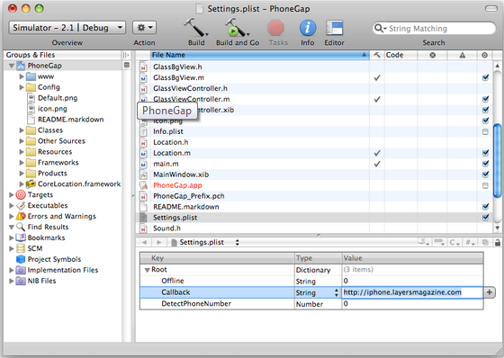

Slide 32
Tools and Libraries
Many toolkits and interface libraries have emerged to aid in the creation of mobile web apps, specifically for the iPhone.
Building on the work of others can be a huge time saver when trying to build a mobile web app.

Slide 33
iUI
Shortly after the iPhone was released, during the first iPhoneDevCamp, developer Joe Hewitt created an open source user interface library that mimics the appearance and interactions of the iPhone.
Originally dubbed iphonenav, the project is now known as iUI , and is one of the more popular tools used for creating iPhone web apps.

Slide 34
iUI
iUI uses CSS and JavaScript to quickly create menus, animated page transitions, and other effects that make your web app feel at home on the iPhone.
It is highly optimized and has a page weight of only 30 KB, making it an ideal toolkit for mobile devices.
It uses the single-page model, loading additional content via Ajax into the view, making it incompatible with browsers that don’t support JavaScript.

Slide 35
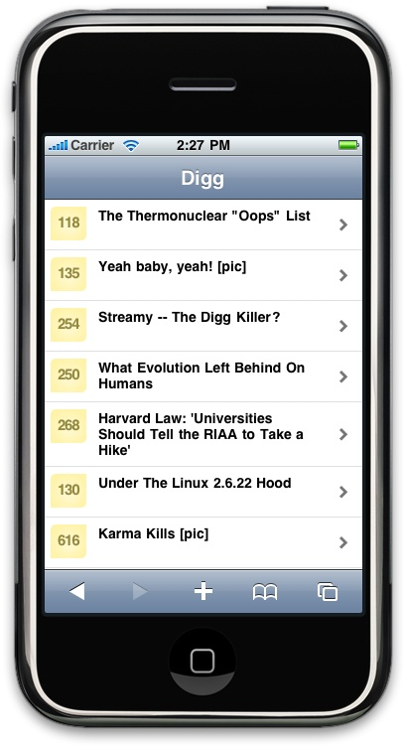

Slide 36
jQTouch
Another interface library called jQTouch is designed to include other WebKit browsers based on the popular JavaScript framework jQuery
Like iUI, jQTouch supports iPhone-style menus, animated page transitions, and effects using CSS transforms.
It is nearly four times larger than iUI—around 112 kilobytes, half of which is just the core jQuery library.

Slide 37
jQTouch
The flexibility of having a library based on jQuery can be useful, meaning that there is the ability to leverage the simple syntax for creating JavaScript-based web apps as well, and the wealth of jQuery plugins.
However, its large file size is certainly an issue to consider before starting to make web apps with jQTouch.

Slide 38
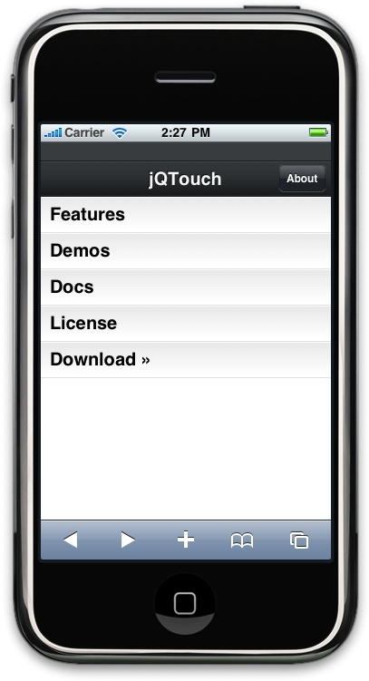

Slide 39
Animation
iPhone apps have a number of distinctive animation characteristics that add context and meaning for the user
JavaScript library called jQTouch that makes mobile web development a whole lot easier.
jQTouch is an open source jQuery plug-in that handles virtually everything

Slide 40
Building an Iphone Like Application
We are going to build a simple calorie-tracking application called Kilo that allows the user to add and delete food entries for a given date. All told, there will be five panels: Home, Settings, Dates, Date, and New Entry. We’ll start off with two panels and work our way up as we go.

Slide 41
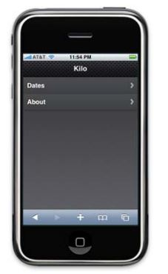

Slide 42
Step - 1
To begin, let’s create a file named index.html and add the HTML for the Home and About panels.

Slide 43
Code
<body> <div id="home"> <div class="toolbar"> <h1>Kilo</h1> </div>
<ul class="edgetoedge"> <li class="arrow">
<a href="#about">About</a></li>
</ul> </div>
<div id="about"> <div class="toolbar"> <h1>About</h1> <a class="button back" href="#">Back</a> </div>

Slide 44
Code Explanation
<div id="home"> This div (as well as the about div that appears a few lines down) will become a panel in the application by virtue of the fact that it is a direct descendant of the body.
<div class="toolbar"> <h1>Kilo</h1> </div> Inside each panel div, there is a div with a class of toolbar. This toolbar class is specifically predefined in the jQTouch themes to style an element like a traditional iPhone toolbar

Slide 45
Code Explanation
<ul class="edgetoedge"> This unordered list tag has the class edgetoedge. The edgetoedge class tells jQTouch to stretch the list all the way from left to right in the viewable area.
<li class="arrow"><a href="#about">About</a></li> On this line there is an li that contains a link with its href pointing at the About panel. Including the arrow class to the li is optional; doing so will add a chevron to the right side of the item in the list.

Slide 46
Code Explanation
<a class="button back" href="#">Back</a> The toolbar elements each contain a single h1 element that will become the panel title. On this line, there is a link with the classes button and back, which tell jQTouch to make the button look and act like a back button.

Slide 47
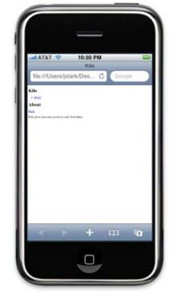

Slide 48
Step – 2 Activating jQtouch
Once you’ve downloaded jQTouch and unzipped it in the same directory as the HTML document, you just add a few lines of code to the head of your page

Slide 49
Activating jQtouch
<link type="text/css" rel="stylesheet" media="screen" href="jqtouch/jqtouch.css">
<link type="text/css" rel="stylesheet" media="screen" href="themes/jqt/theme.css">
<script type="text/javascript" src="jqtouch/jquery.js"></script>
<script type="text/javascript" src="jqtouch/jqtouch.js"></script>
<script type="text/javascript"> var jQT = $.jQTouch({ icon: 'kilo.png', statusBar: 'black' }); </script>

Slide 50
Code Explanation
<link type="text/css" rel="stylesheet" media="screen" href="jqtouch/jqtouch.css">
I’m including the jqtouch.css file. This file defines some hardcore structural design rules that are very specific to handling animations, orientation, and other iPhone specifics. This file is required and there should be no reason for you to edit it.

Slide 51
Code Explanation
<link type="text/css" rel="stylesheet" media="screen" href="themes/jqt/theme.css"> I’m including the CSS for my selected theme, in this case, the “jqt” theme, which comes with jQTouch. The classes that I’ve been using in the HTML correspond to CSS selectors in this document. jQTouch comes with two themes available by default

Slide 52
Code Explanation
<script type="text/javascript" src="jqtouch/jquery.js"></script>
jQTouch requires jQuery, so I include that here. jQTouch comes with its own copy of jQuery, but you can link to another copy if you prefer.

Slide 53
Code Explanation
<script type="text/javascript" src="jqtouch/jqtouch.js"></script> This is where I include jQTouch itself. Note that you have to include jQTouch after jQuery, or nothing’s going to work.

Slide 54
Code Explanation
<script type="text/javascript"> var jQT = $.jQTouch({ icon: 'kilo.png', statusBar: 'black' }); </script> This brings us to the script block where I initialize the jQTouch object and send in two property values: icon and statusBar.

Slide 55
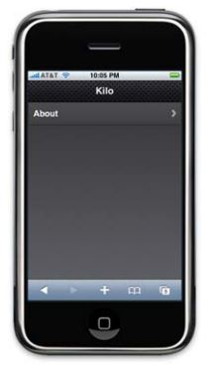

Slide 56
Step – 3 Creating the dates panel
<div id="dates"> <div class="toolbar"> <h1>Dates</h1> <a class="button back" href="#">Back</a> </div> <ul class="edgetoedge"> <li class="arrow"><a id="0" href="#date">Today</a></li> <li class="arrow"><a id="1" href="#date">Yesterday</a></li> <li class="arrow"><a id="2" href="#date">2 Days Ago</a></li> <li class="arrow"><a id="3" href="#date">3 Days Ago</a></li> <li class="arrow"><a id="4" href="#date">4 Days Ago</a></li> <li class="arrow"><a id="5" href="#date">5 Days Ago</a></li> </ul> </div>

Slide 57
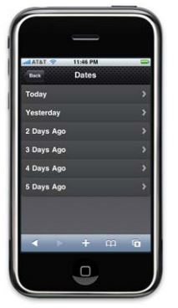

Slide 58
Step – 4 Adding the dates panel
<div id="home"> <div class="toolbar"> <h1>Kilo</h1> </div> <ul class="edgetoedge"> <li class="arrow"><a href="#dates">Dates</a></li> <li class="arrow"><a href="#about">About</a></li> </ul> </div>

